Slide 1


Thuc Nhi Ly
2023-18-09

Slide 2

Outline
Executive Summary
Introduction
Methodology
Results
Conclusion
Appendix

Slide 3
Executive Summary
Summary of methodologies
We collect the data through requesting the SpaceX API and extract the data of Falcon 9. We also do web wrapping to extract the data from Wikipedia. For the data wrangling, we would perform exploratory Data Analysis and determine Training Labels. We also work with the database to filter the data. We work with Folium to analyze launch site locations. We build machine learning algorithm for model classification. We also build Plotly Dash dashboard for data visualization and interaction.
Summary of all results
ES-L1, GEO, HEO, and SSO orbit has the highest successful rate.
All the model have the same accurate result of approximately 0.83 ~ 0.84.
All model do the better job on predicting the landed outcome since 12 landed cases was predicted and 0 did-not-land case was also predicted Point 4.

Slide 4
Introduction
Project background and context
SpaceX announced their Falcon 9 rocket costed 62 million dollars per launch while other providers costed over 165 million dollar each. The reason for the difference in cost is because SpaceX can reuse the first stage.
Problems you want to find answers
In this project, we will predict if the Falcon 9 first stage will land successfully, hence the result can be used to determine the cost of a launch.

Slide 5

Section 1

Slide 6
Methodology
Executive Summary
Data collection methodology:
Describe how data was collected
Perform data wrangling
Describe how data was processed
Perform exploratory data analysis (EDA) using visualization and SQL
Perform interactive visual analytics using Folium and Plotly Dash
Perform predictive analysis using classification models
How to build, tune, evaluate classification models

Slide 7
Data Collection
Data collection methods:
Making a get request to the SpaceX API
Data wrangling and formatting.

Slide 8
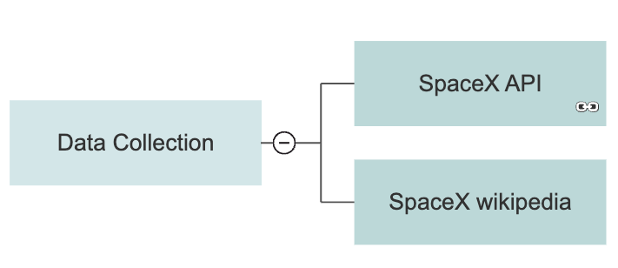
Data Collection – SpaceX API
Data collection with SpaceX REST calls using key phrases and flowcharts

Slide 9
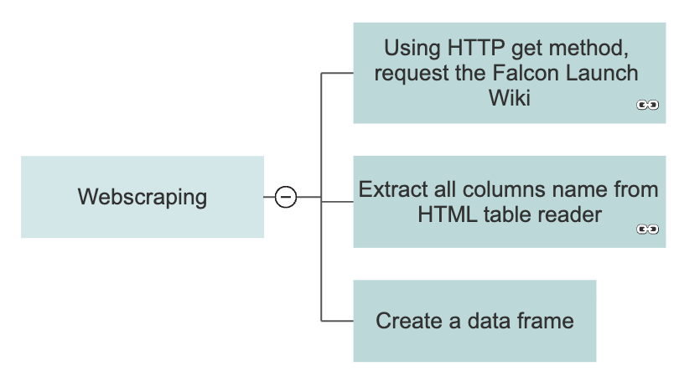
Data Collection - Scraping
Present your web scraping process using key phrases and flowcharts

Slide 10
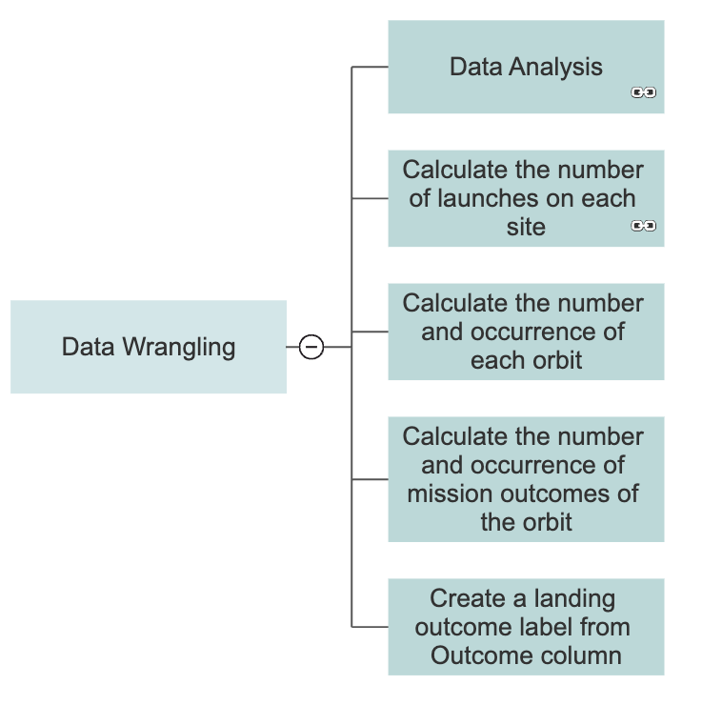
Data Wrangling
How data were processed:
Performing Exploratory Data Analysis (EDA) to find some patterns in the data
Determining the label for training supervised models
Training Labels include:
1: Successfully landed
0: Unsuccessfully landed

Slide 11
EDA with Data Visualization
Summarize what charts were plotted and why you used those charts
Scatter Plot: represent the different success rates based on different launch sites
Bar Chart: represent the success rate of each orbit
Line Chart: represent the trend in success rate during the extracted years

Slide 12
EDA with SQL
Using bullet point format, summarize the SQL queries you performed
Display the names of the unique launch sites
Display 5 of the launch site in which the name begin with ‘CCA’
Display the total of Payload Mass from Nasa
Display the average of Payload Mass from Booster names ‘F9 v1.1’
Display the unique landing outcome
Display the list of Booster where payload mass is between 4000 and 6000
Count the number of success and failure landing outcome
Display the list of Booster where payload mass is the heaviest
Display the month, booster version and launch site of the failure landing outcome in 2015
Count the number of each landing outcome from 2010 to 2017

Slide 13
Build an Interactive Map with Folium
Summarize what map objects such as markers, circles, lines, etc. you created and added to a folium map
Added marker and circle to mark the NASA Johnson Space Center’s location on the folium map.
Added circle and marker for each launch site (CCAFS LC-40, CCAFS SLC-40, KSC LC-39A, VAFB SLC-4E).
Create markers for all launch records using marker clusters.
Added a MousePosition on the map to get coordinate for a mouse over a point on the map.
Draw lines between a launch site to its closest coastline, city, and railway.

Slide 14
Build a Dashboard with Plotly Dash
The Dashboard includes a Pie Chart and a Scatter Plot.
Pie Chart: Show the success rate for each launch sites and for all sites
Scatter Plot: Indicate the correlation between Payload and Success base on the different Payload range.

Slide 15
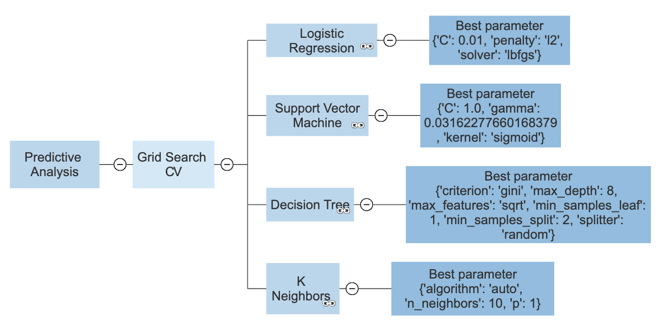
Predictive Analysis (Classification)
We will build models to predict whether the Falcon9 will land successfully using Grid Search model selection method. We will apply Logistic Regression, Support Vector Machine, Decision Tree, K Neighbors classification algorithm

Slide 16
Results
Exploratory data analysis results
When observing the correlation between launch sites and flight number, we see that different launch sites have different success rates. CCAFS LC-40, has a success rate of 60%, the ratio of the dots in class 0 (failure) are more compared to the ratio of the dots in class 0 of KSC LC-39A and VAFB. The reason is because the success rate of these two launch sites is higher which the rate of 77%.
From the bar-chart for the success rate of each orbit, we can see that ES-L1, GEO, HEO, and SSO orbit has the highest successful rate.
Predictive analysis results:
All the model have the same accurate result of approximately 0.83 ~ 0.84.

Slide 17

Section 2

Slide 18
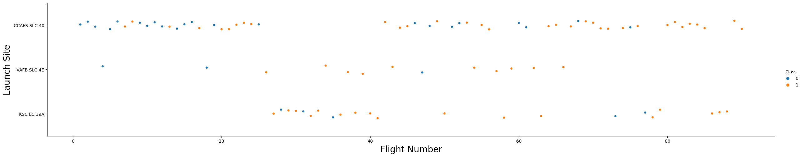
Flight Number vs. Launch Site
Scatter plot of Flight Number vs. Launch Site

Slide 19
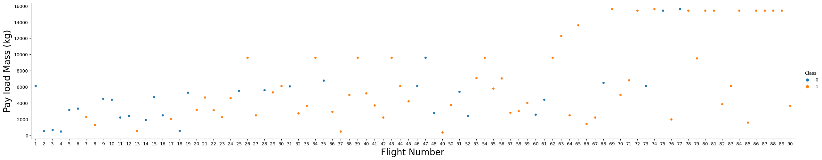
Payload vs. Launch Site
Scatter plot of Payload vs. Launch Site

Slide 20
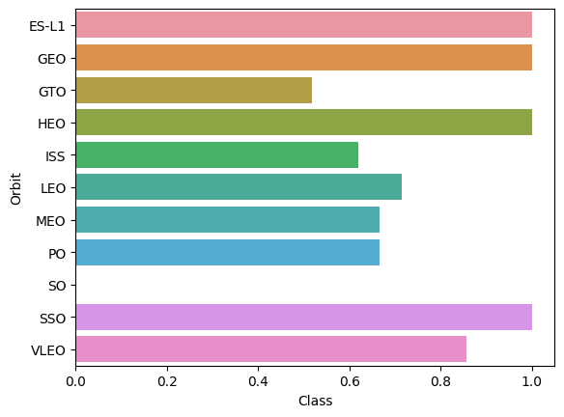
Success Rate vs. Orbit Type
Bar chart for the success rate of each orbit type

Slide 21
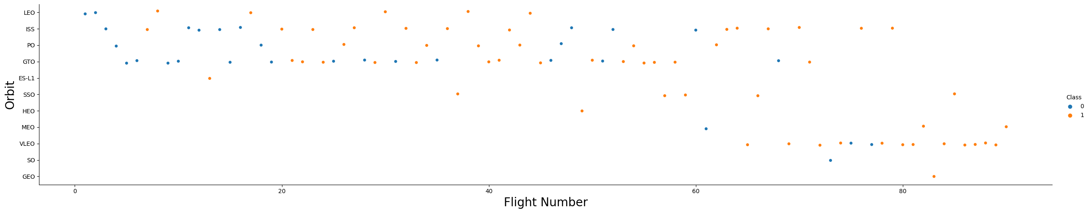
Flight Number vs. Orbit Type
Scatter plot point of Flight number vs. Orbit type

Slide 22
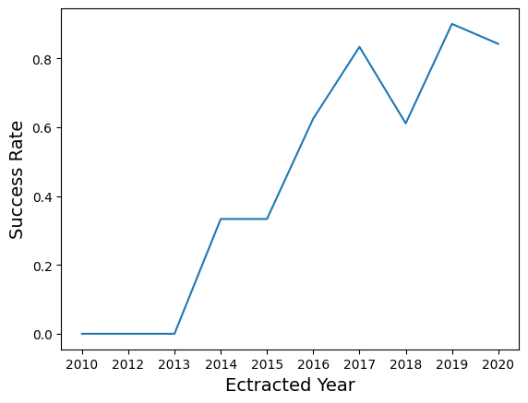
Launch Success Yearly Trend
Line chart of yearly average success rate

Slide 23
All Launch Site Names
The names of the unique launch sites:
CCAFS LC-40
VAFB SLC-4E
KSC LC-39A
CCAFS SLC-40
%sql select distinct Launch_Site from SPACEXTABLE

Slide 24
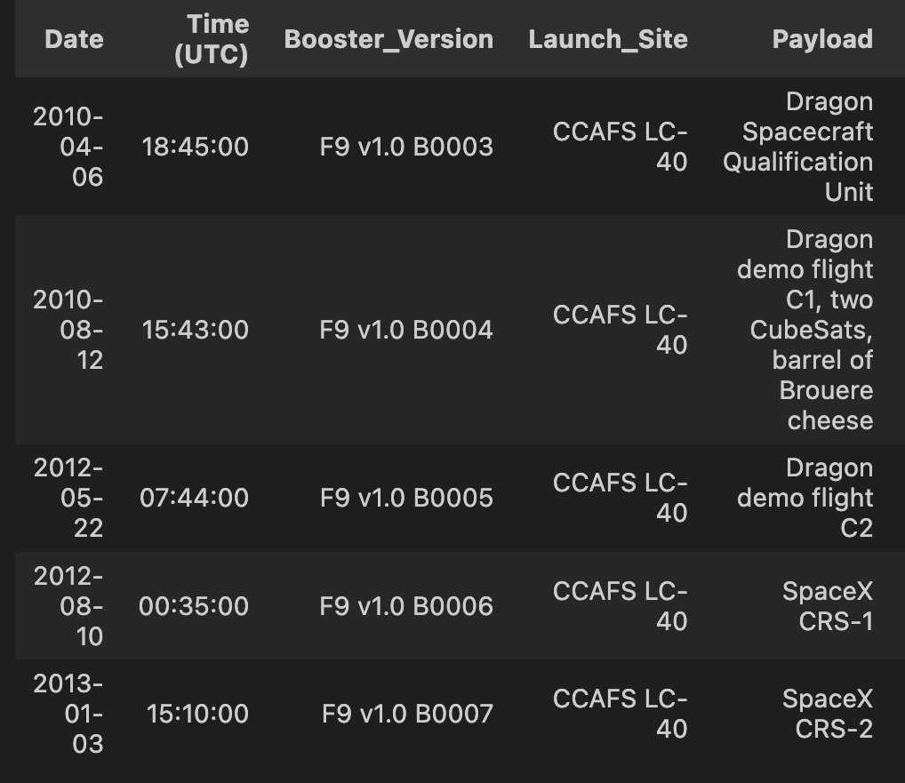
Launch Site Names Begin with 'CCA'
Find 5 records where launch sites begin with `CCA`
%sql select * from SPACEXTABLE where Launch_Site like 'CCA%' limit 5

Slide 25
Total Payload Mass
Calculate the total payload carried by boosters from NASA
%sql select sum (PAYLOAD_MASS__KG_) from SPACEXTABLE where Customer == 'NASA (CRS)’
Query result:
Sum(PAYLOAD_MASS_KG) = 45596

Slide 26
Average Payload Mass by F9 v1.1
Calculate the average payload mass carried by booster version F9 v1.1
%sql select avg(PAYLOAD_MASS__KG_) from SPACEXTABLE where Booster_Version == 'F9 v1.1’
Query result
Avg(PAYLOAD_MASS__KG_) = 2928.4

Slide 27
First Successful Ground Landing Date
Find the dates of the first successful landing outcome on ground pad
%sql select min(Date) from SPACEXTABLE where Landing_Outcome == 'Success (ground pad)’
Query result:
Date: 2015-12-22

Slide 28
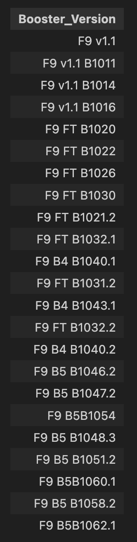
Successful Drone Ship Landing with Payload between 4000 and 6000
List the names of boosters which have successfully landed on drone ship and had payload mass greater than 4000 but less than 6000
%sql select Booster_Version from SPACEXTABLE where PAYLOAD_MASS__KG_ > 4000 AND PAYLOAD_MASS__KG_ < 6000

Slide 29
Total Number of Successful and Failure Mission Outcomes
Calculate the total number of successful and failure mission outcomes
%sql select count(*) from SPACEXTABLE where Landing_Outcome like 'success%'
%sql select count(*) from SPACEXTABLE where Landing_Outcome like 'failure%’
Query result:
Success: count(*): 61
Failure: count(*): 10

Slide 30
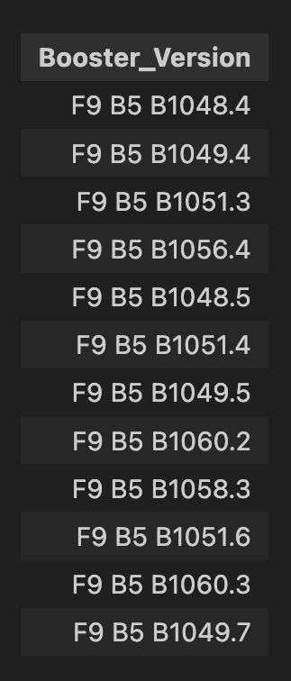
Boosters Carried Maximum Payload
List the names of the booster which have carried the maximum payload mass
%sql select Booster_Version from SPACEXTABLE where PAYLOAD_MASS__KG_ == (Select max(PAYLOAD_MASS__KG_) from SPACEXTABLE)
Query result:

Slide 31
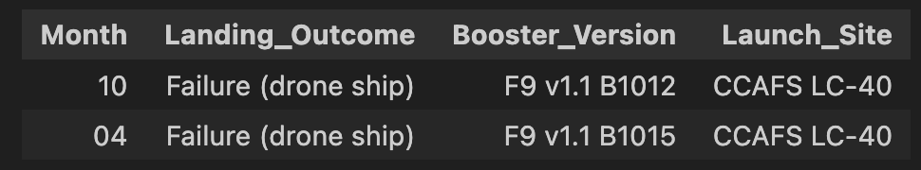
2015 Launch Records
List the failed landing_outcomes in drone ship, their booster versions, and launch site names for in year 2015
%sql select substr(Date,6,2) as Month, Landing_Outcome, Booster_Version, Launch_Site from SPACEXTABLE where (Landing_Outcome = 'Failure (drone ship)' and substr(Date,1,4)= '2015’).

Slide 32
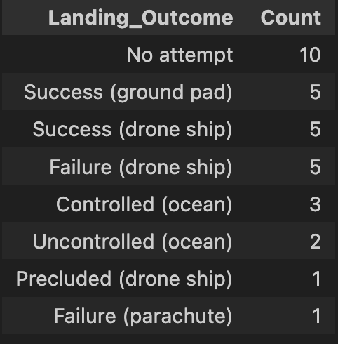
Rank Landing Outcomes Between 2010-06-04 and 2017-03-20
Rank the count of landing outcomes (such as Failure (drone ship) or Success (ground pad)) between the date 2010-06-04 and 2017-03-20, in descending order
%sql select Landing_Outcome, count(Landing_Outcome) as Count from SPACEXTABLE where '2010-06-04'< Date and Date < '2017-03-20' group by Landing_Outcome order by Count desc

Slide 33

Section 3

Slide 34
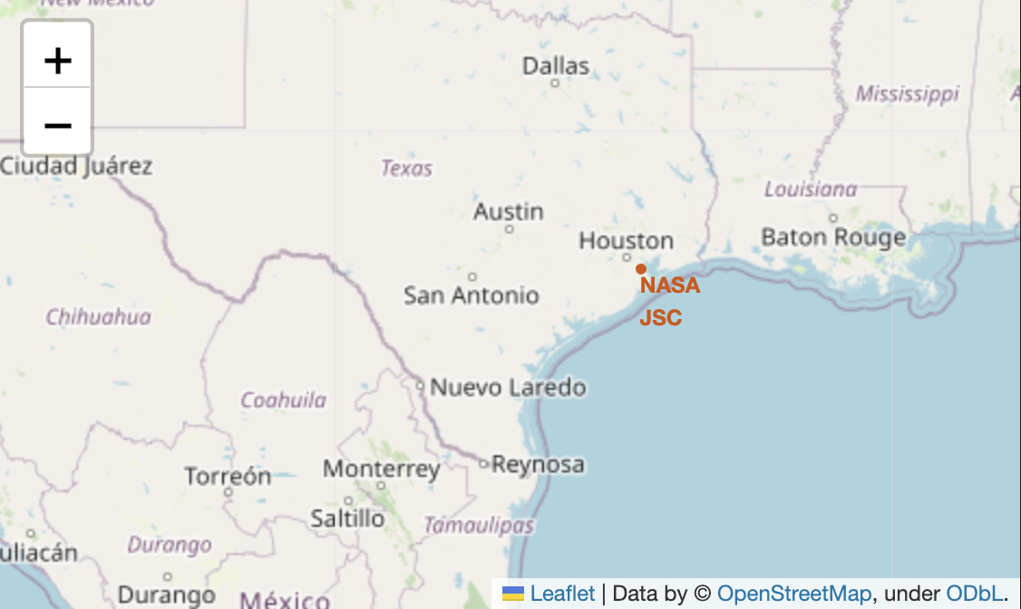
NASA LOCATION
NASA location on the world map.

Slide 35
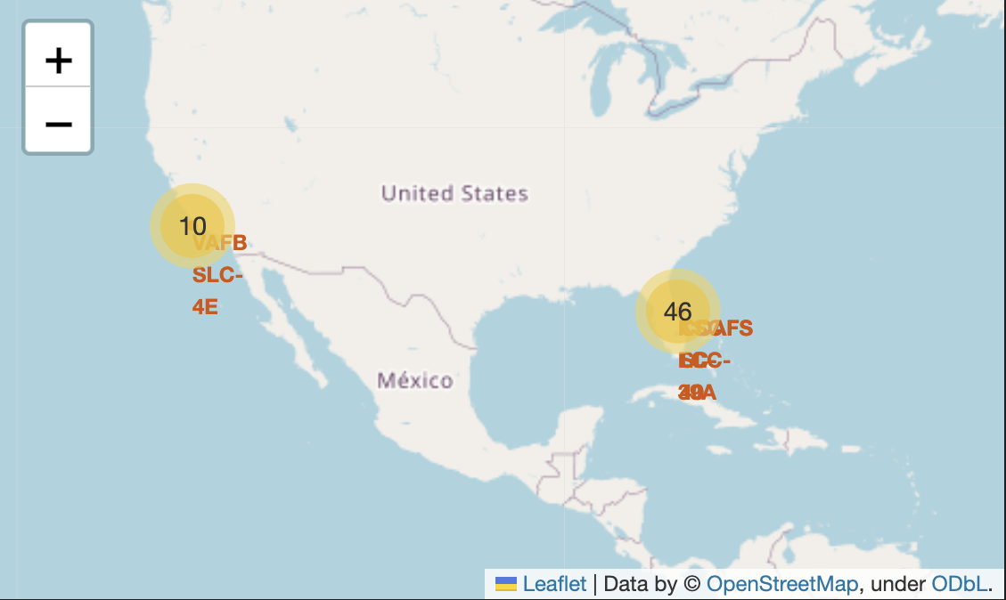
Launch Site locations
Launch site] locations on the world map using Folium

Slide 36
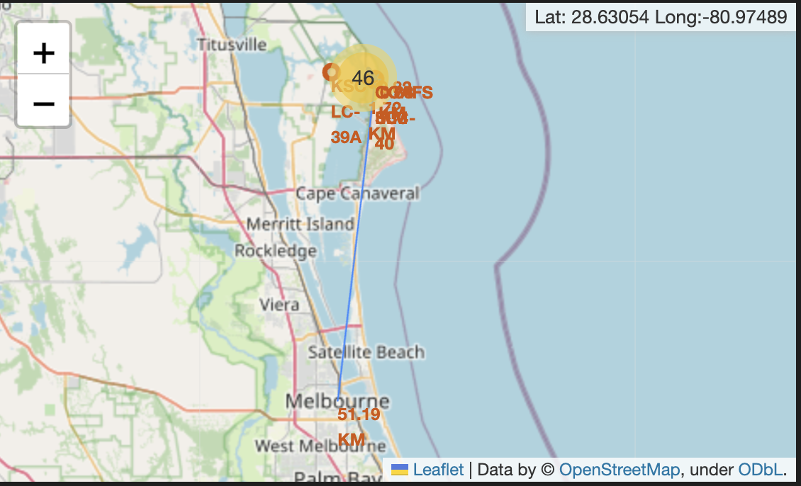
Launch site locations
Explore the generated folium map and show the screenshot of a selected launch site to its proximities such as railway, highway, coastline, with distance calculated and displayed

Slide 37

Section 4

Slide 38
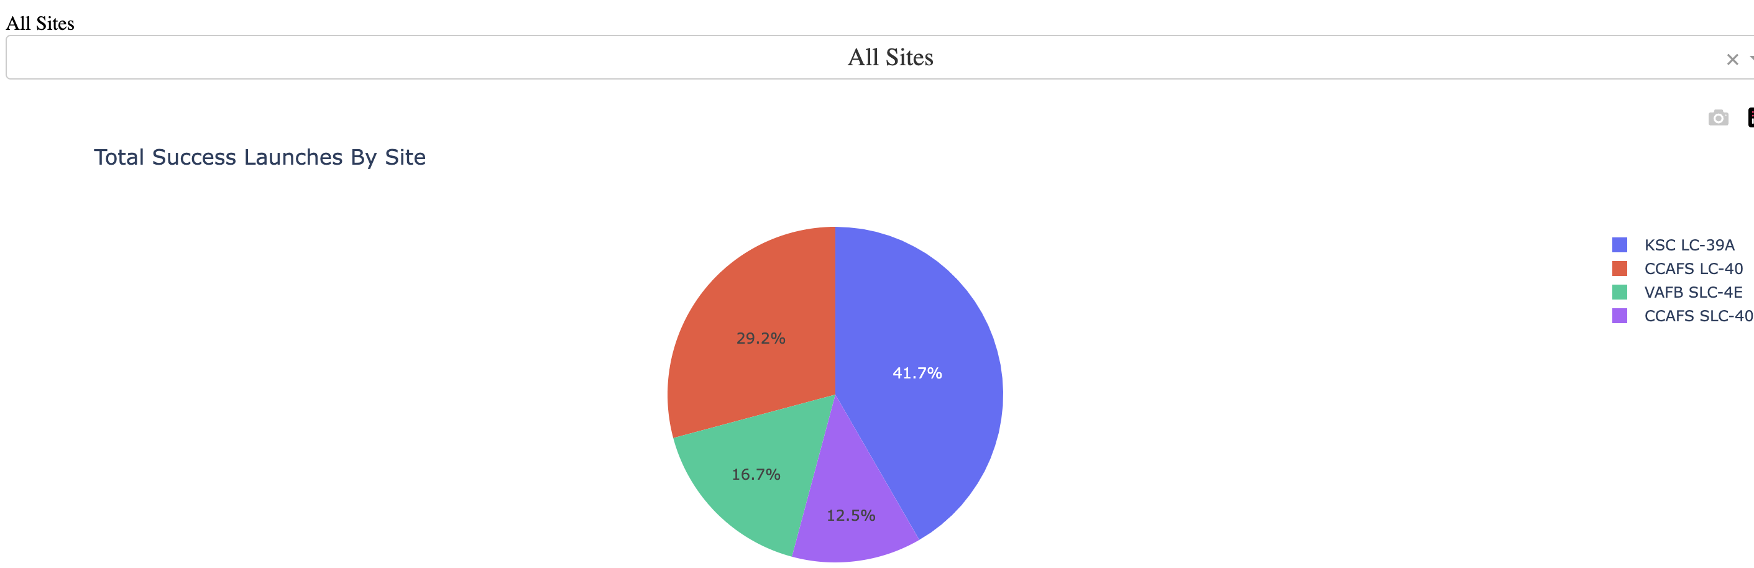
Launch success count for all sites
Launch success count for all sites, in a piechart

Slide 39
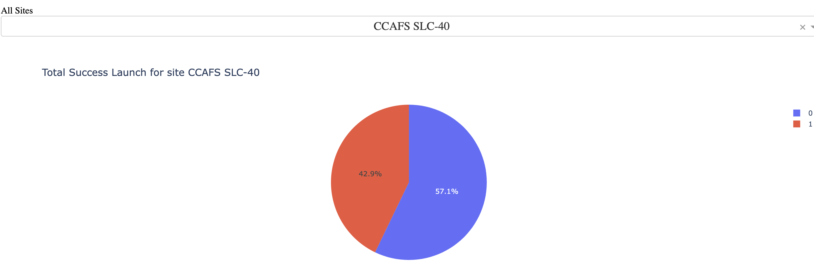
CCAFS SLC-40 launch rate
The pie chart for the launch site with highest launch success ratio with the success rate of approximately 42%

Slide 40
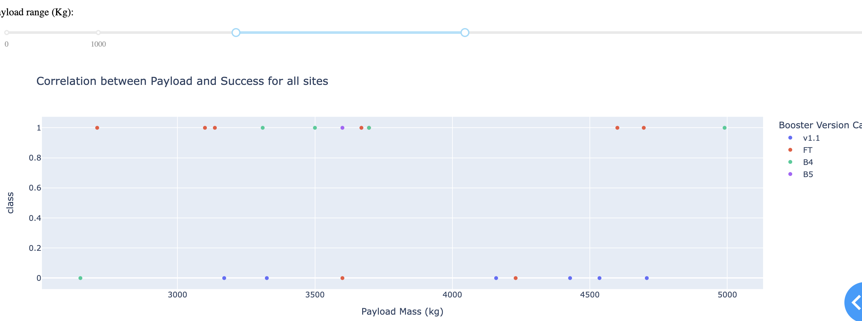
Payload and Success
Screenshot of Payload vs. Launch Outcome scatter plot for all sites, with different payload selected in the range slider

Slide 41

Section 5

Slide 42
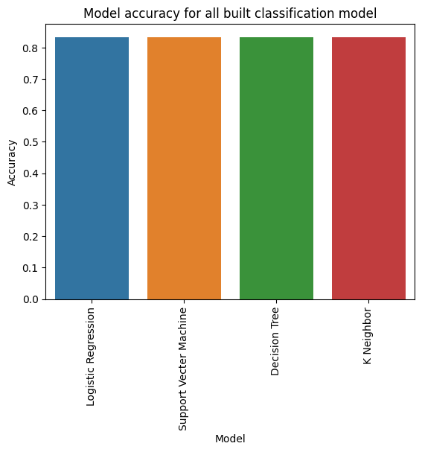
Classification Accuracy
Visualize the built model accuracy for all built classification models, in a bar chart.
All the built model classification have the same accuracy score.

Slide 43

Confusion Matrix
Since all the built model classification have the same accuracy score, we have the same confusion matrix from all models..
As the result, all model do the better job on predicting the landed outcome since 12 landed cases was predicted and 0 did-not-land case was also predicted.

Slide 44
Conclusions
ES-L1, GEO, HEO, and SSO orbit has the highest successful rate.
All the model have the same accurate result of approximately 0.83 ~ 0.84
All model do the better job on predicting the landed outcome since 12 landed cases was predicted and 0 did-not-land case was also predicted Point 4

Slide 45
Appendix
Github link of the notebook:
https://github.com/nalini97/spacex-project/blob/nalini97-patch-2/SpaceX_project.ipynb

Slide 46


